Slide 1

IMPORT MODULE

Slide 2
OBJECTIVE
By the end of the class Global Learners will be able to
Import programs as modules
Invoking functions in main module Only when in main program

Slide 3
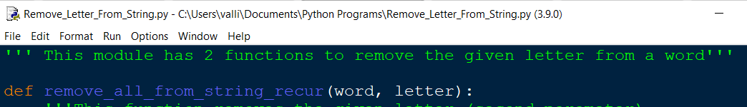
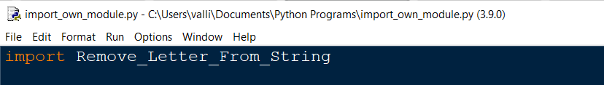
How to import modules?
Define functions in a python program ( Ex: Open the remove letter from a string program where functions are defined )
Open a new python file and import using the file name( both the python files must be in the same folder)

Slide 4
Execute the new file
What happens when the program where you have imported your own module is executed?

Slide 5
Execute the new file
If the functions are invoked in the main program( the module that is imported) it will get executed automatically.
But, Is that what is expected when we import a module?

Slide 6
How to avoid executing the main program ?
Every module in Python has a special attribute called __name__. The value of __name__ attribute is set to “__main__” when module is run as main program. Otherwise, the value of __name__ is set to contain the name of the module.
We use if __name__ == “__main__” block to prevent (certain) code from being run when the module is imported.

Slide 7
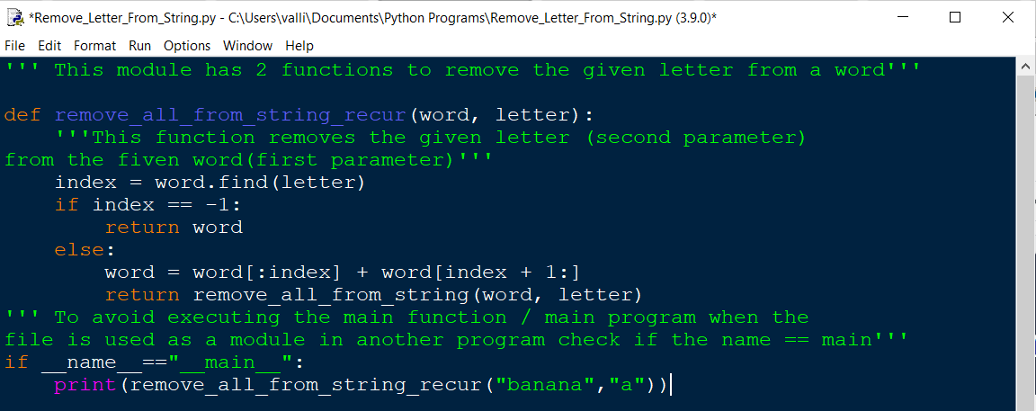
Avoid Executing the main program

Slide 8
Avoid Executing the main program
Now execute the new file where the module is imported

Slide 9
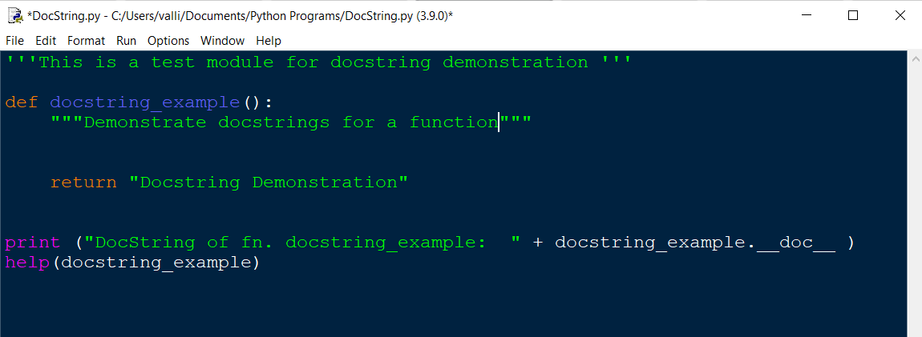
DOC STRING - Details about Module / Functions
Use triple quotes to add details about the module or functions in the module
Use __doc__ attribute to access the details
help(function_name) could also be used to get details about the function

Slide 10
Exercise
Write a program to remove all the vowels in a given text file. Importing your own program as module is mandatory.
Import the module( your program) which has the function for removing a letter from a string.
Use the function to remove all the vowels in the given text( input will be read from a file)
Write the output in a new text file.

